Slide 1
Ecommerce Data Analysis
August 11, 2024
Prepared by: Shubhangi Bansal

Slide 2
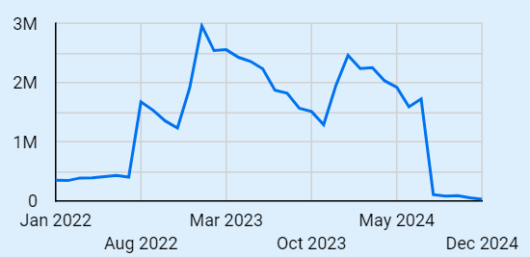
SALES PERFORMANCE ANALYSIS It is identified that highest total sales ($2,958,147.10) were observed in January 2023. Although, the highest Average Order Value ($309.48) was observed in October 2024.

Slide 3
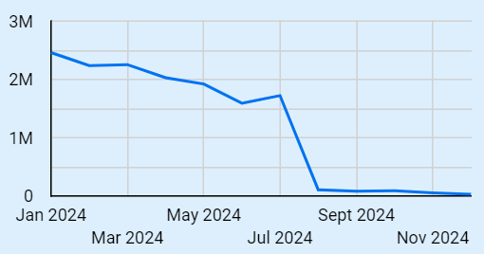
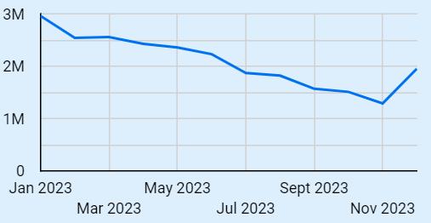
TIME SERIES ANALYSIS Using the Time-Series plot it has been observed that the highest peaks are achieved in January 2023 and January 2024. This might indicate an increased sales during the Christmas-New Year holidays. Also, the total sales decreases steadily from January to November of 2023 as well as 2024.

Slide 4
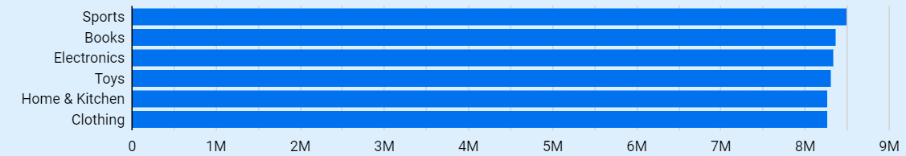
PRODUCT PERFORMANCE From the bar graph, it can be observed that highest total sales ($8,502,385.50). The highest average sales ($257.77) were observed for the Product Category Sports.

Slide 5
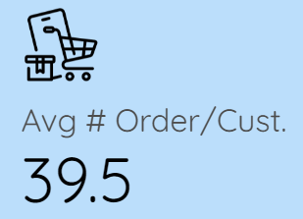
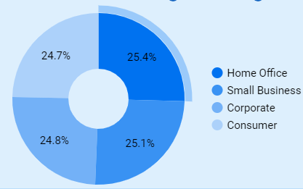
CUSTOMER INSIGHTS It is identified that the top customer segments by total sales are Home Office, Small Business, Corporate and Consumer with their respective percentage contribution to total sales being 25.4%, 25.1%, 24.8% and 24.7%. Also there are 168 customers with highest number of repeated orders, i.e., 10. The average number of orders per customer is 39.5.

Slide 6
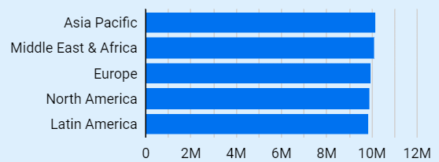
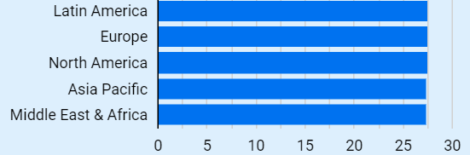
REGIONAL ANALYSIS
It can be observed that highest total sales total sales ($10,192,202) were for Asia Pacific Region, while the highest average total sales total sales ($1,834,799) were observed for the Middle Eastern Region. | It is identified that highest average shipping cost ($21.56) was observed for the Latin American Region.

Slide 7
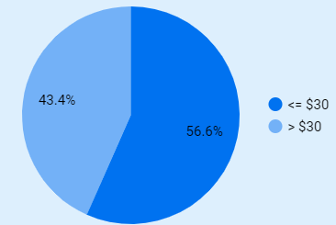
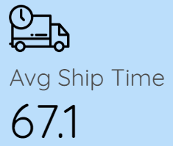
SHIPPING AND FULFILMENT ANALYSIS It is observed that the maximum, minimum and average number of days to ship orders is 353, 0 and 67.13, respectively. As is evident from the pie chart, 43.4% orders have shipping charges greater than $30. | CUSTOMER RETENTION It is concluded that all customers included in the given database have placed orders more than once with the ecommerce website. Also, the average number of days between orders for customers varies from 24.5 to 443 days.

Slide 8
RECOMMENDATIONS Actionable Steps: Introducing seasonal promotions, flash sales, loyalty programs, discounts on complimenting products, referral programs, marketing campaigns, collaborations, building communities to increase sales. Strategic Implications: The strategies mentioned above can potentially attract more customers round the year.

Slide 9
EXIT DASHBOARD
THANKYOU
____________________________________________

